Slide 1
Modeling & Predicting Optimal NBA Lineups
IEOR 142 - Machine Learning & Data Analytics
Wesley Graham, Sid Iyer, Sparsh Jain,
Nabeil Kizilbash, Roshan Srinivasan

Slide 2

motivation

Slide 3
NBA Salary Splurge
Average NBA Team Budget: $126.7M
(This number includes the luxury tax on top of the NBA salary caps)

Slide 4
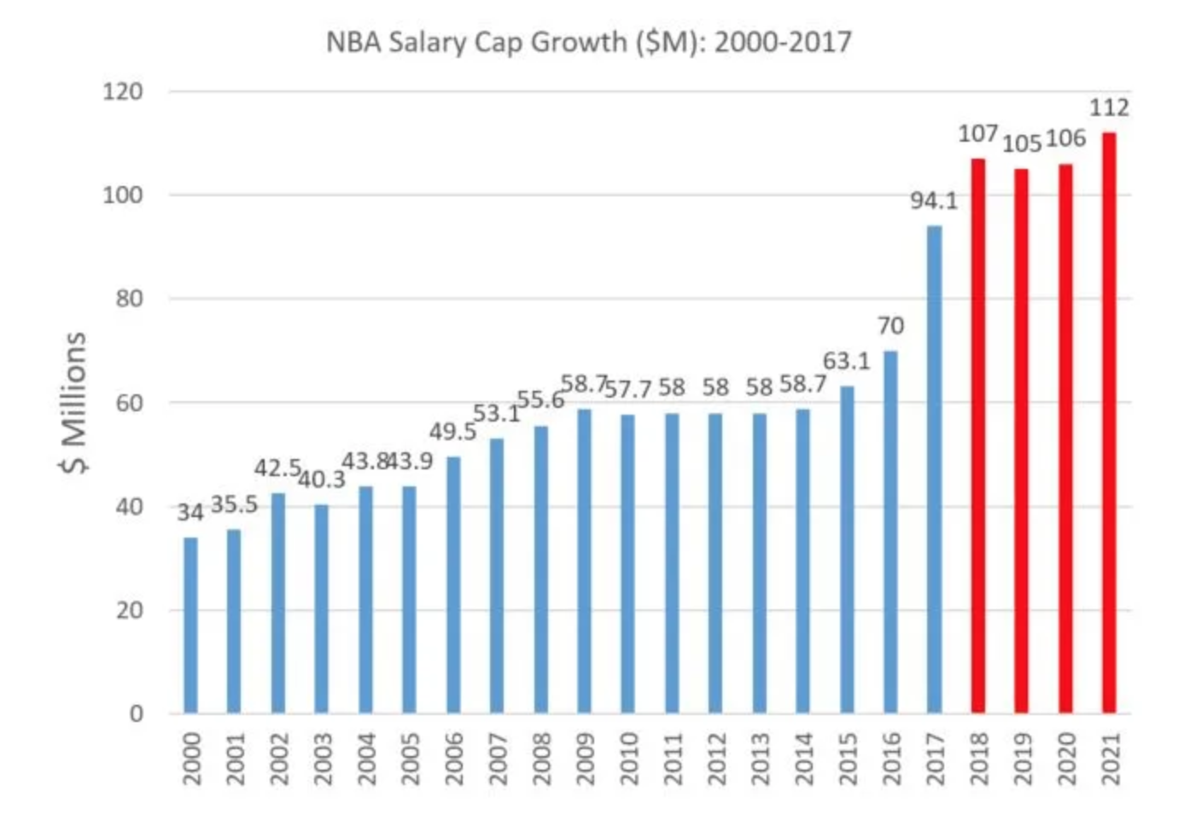
Salary Cap Growth

Slide 5

data

Slide 6
Data Used for Analysis
Salary data scraped from ESPN.com
Fantasy point formula taken from NBA.com
Previous NBA player seasonal performance data taken from basketball-reference.com
Data merge based on unique primary key identifiers for each NBA player.
This prevented a loss of data during merging due to same names/foreign language characters that were not read by R correctly.
Relevant Features:
Player Salary
Player’s Fantasy Points
Field Goals, Blocks, and Steals
Player’s Position

Slide 7

modeling

Slide 8
Techniques Used in Modeling
The data is split into a training set containing data from 2017-2018 and 2018-2019 and a test set containing data from 2016-2017.
Reasoning: The 2018-2019 dataset contains a variety of starting positions for some players. (Ie. if a player starts as both a point guard and center over the course of multiple games, the position label is PG-C so there is no classification into one specific group.)
The training set is 72.6% of the total data
Objective: To determine optimal player value based on total fantasy points and salary per year. As such, the response variable in our model is salary/fantasy points.

Slide 9
Techniques Used in Modeling Cont.
The baseline model is to assume that there is no predictive power in our model and to choose the optimal team selection based on the players with the lowest salary/fantasy points are the best players to choose.
The OSR2 = 0 for this model.
Initial model: a random forest model on 29 features including age, team, % of 3 pointers scored, Free Throw count and %, etc.
By using tuneRF in R, we tuned the mtry value to 3, nodesize to 5 and ntree to 300.
The OSR2 =~ 0.43.
Improving model accuracy: we used linear regression to identify high correlations between features and remove features using VIF scores.
We applied random forest again after tuning with mtry= 15, nodesize = 9, ntree = 1000.
The OSR2 =~ 0.60

Slide 10
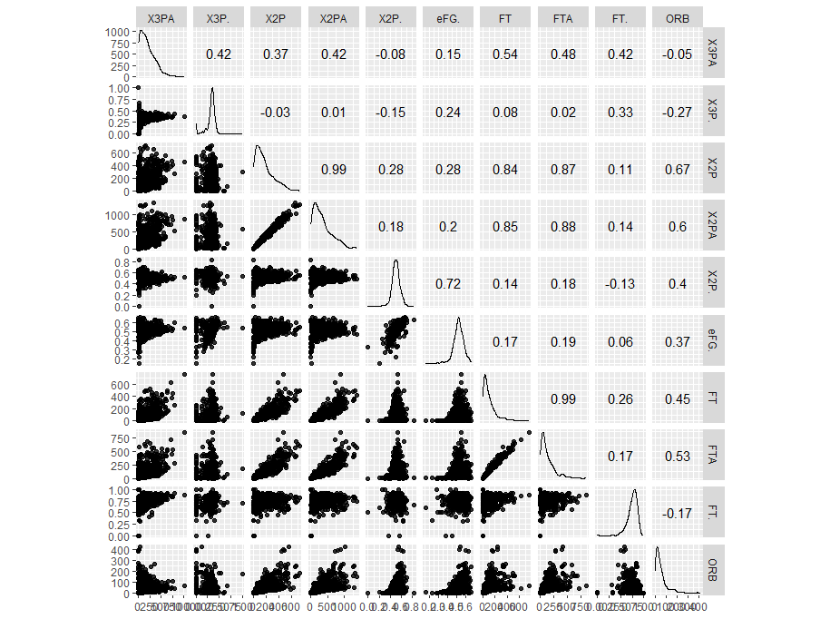
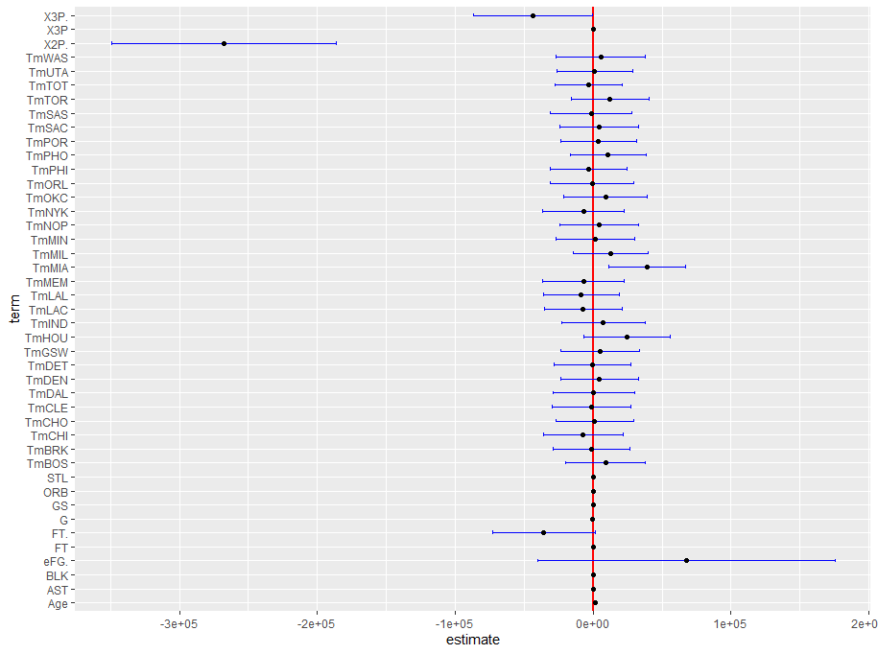
Feature Engineering using Linear Regression
In red are examples of features with high correlation
Final Confidence Interval of Linear Regression Model with all VIF scores <= 5.

Slide 11
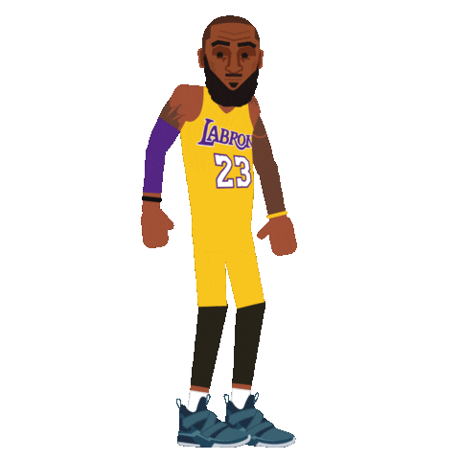
analytics

Slide 12
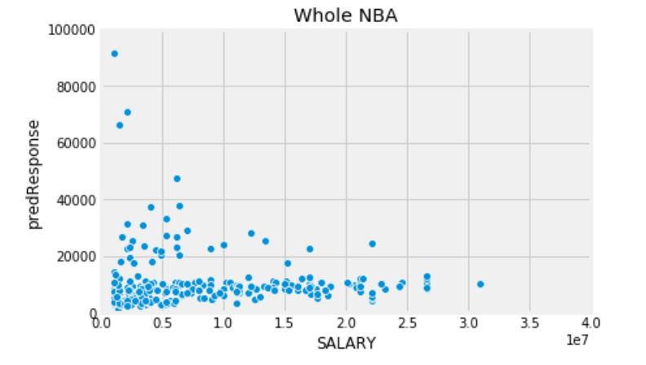
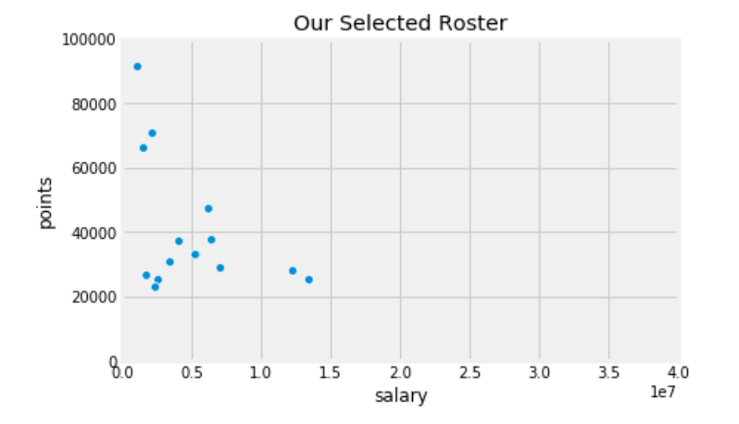
Roster Selection Criteria
Constraints:
Min PG’s: 2, Min SG’s: 2, Min SF’s: 2, Min PF’s: 2, Min C’s: 2
Total Roster Size: 15
Total Working Salary: $109.140 million

Slide 13
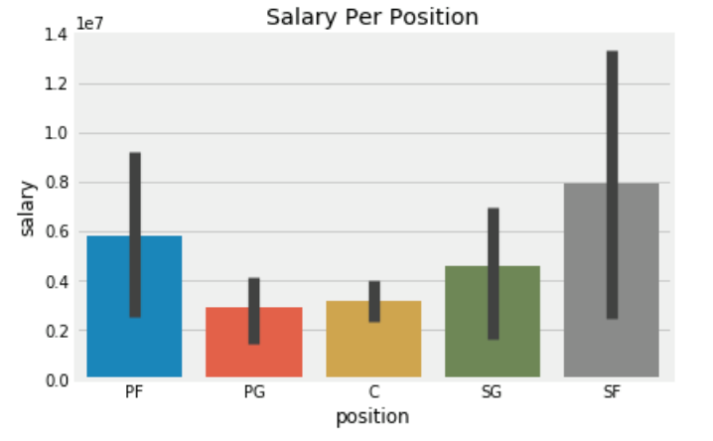
Total Salary Expended
$73,775,000
(68% of Cap)

Slide 14
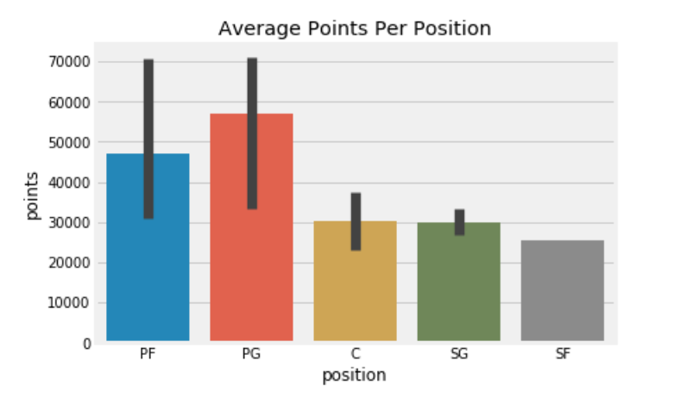
Average Fantasy Points Per Position
Our Average Points/Player: 40,512
League Average Points/Player: 10,800
Our $/Point Spent: $156
League Average $/Point Spent: $8,750

Slide 15
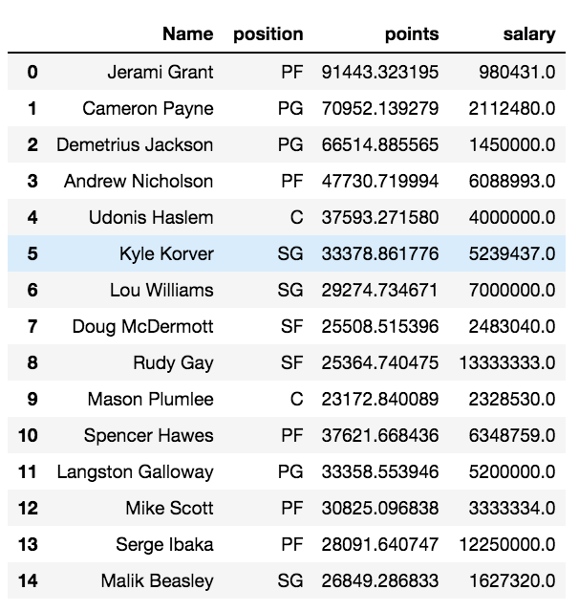
Final Lineup
Total Fantasy Points Generated: 607,680
Next Best NBA Team’s Fantasy Points Generated: 146,445

Slide 16
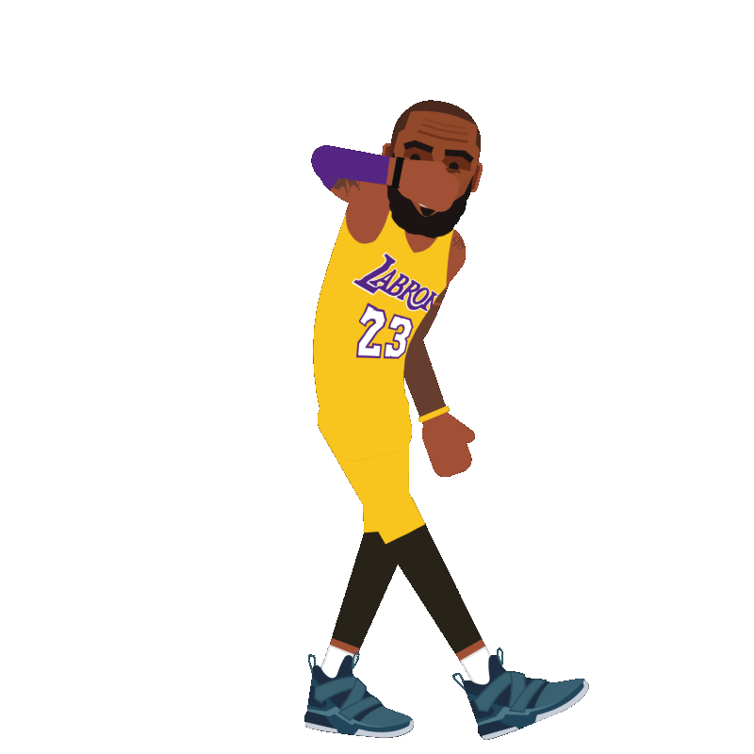
impact

Slide 17

The Impact of Data on Sports (and more!)
Increased usage of data in sports has resulted in a new era of more efficient decision-making and increased monetary gains.
As an NBA owner, one would want to use as much data as possible, including crowdsourced metrics such as fantasy data, to ensure highest ROI and ultimately success.
However, given that this a team sport, one caveat of our model is if it ultimately contributes to wins for a team. For example, would having the best players on a team cannibalize each player’s stats and performance? How will that affect each player’s value?
In a world where data analysis is increasingly important, those who effectively can use data to their advantage to predict efficient outcomes will be the most successful.
Notes:
Our model does great from a statistical point of view, but one caveat is: how does our model contribute ultimately to wins?
Also, given that basketball is a team sport and given a finite number of rebounds, for example, in a game, having the best or most efficient players on the same time will cannibalize statistics, how will that influence wins and ultimately the value of each player?

Slide 18
thank you

